Slide 1
The water cycle
Silvia Caldararu
Email: caldaras@tcd.ie

Slide 2

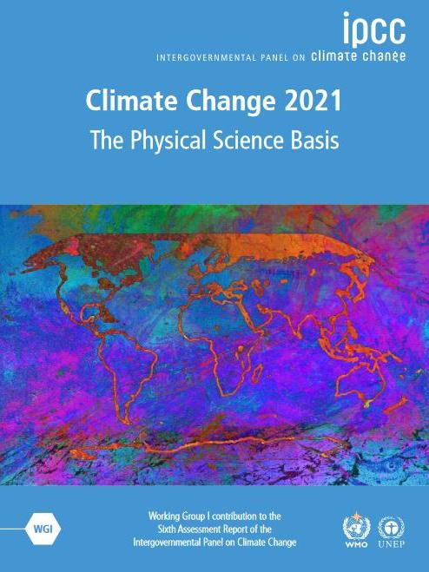
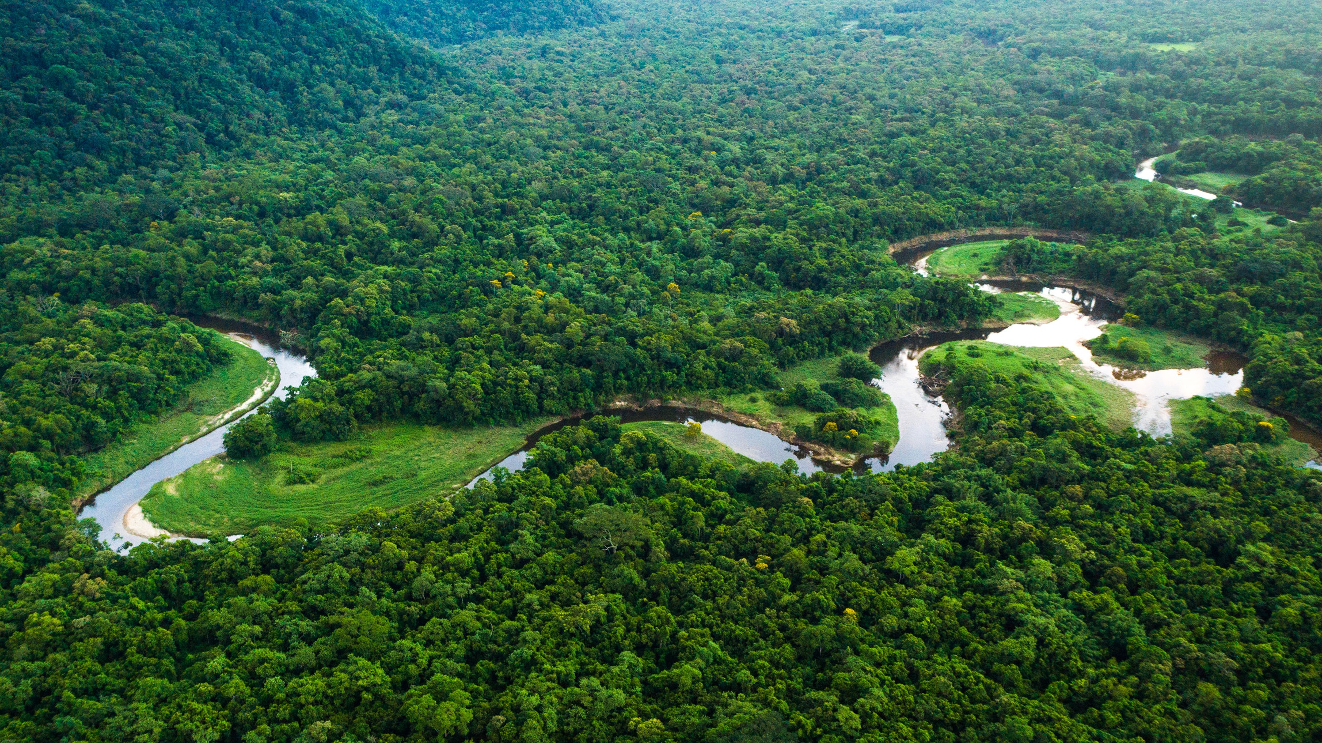

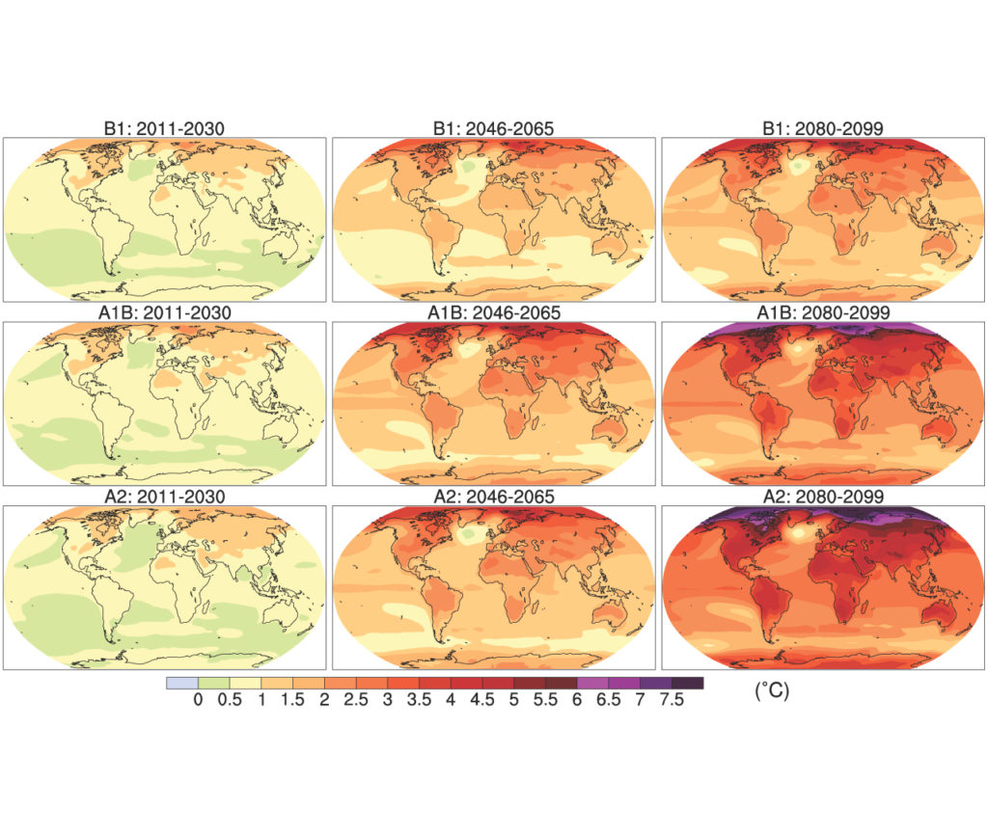
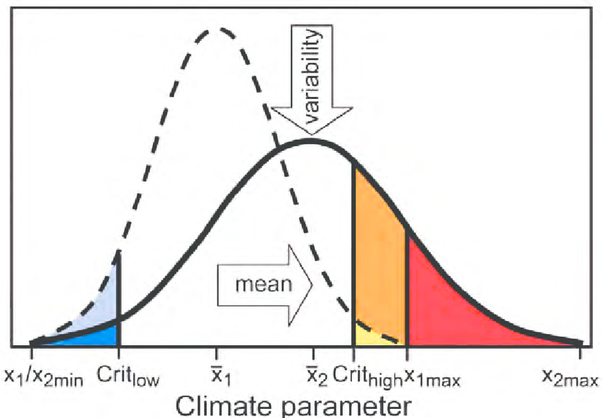
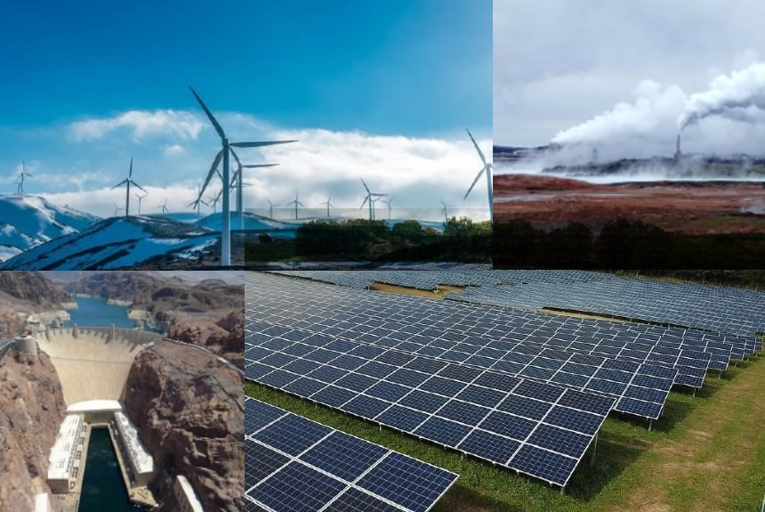
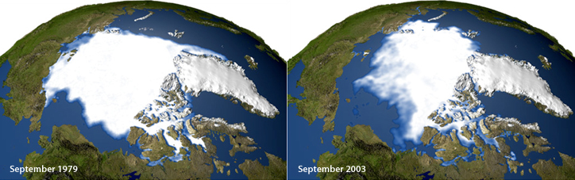
Atmosphere
Climate fundamentals
Predicting climate
Atmosphere
Global C cycle
IPCC report
Earth system models
Climate impacts
Climate solutions
Extreme events
Tipping points
Sea ice, ice caps,
Energy
Mitigation
Nature-based solutions

Slide 3
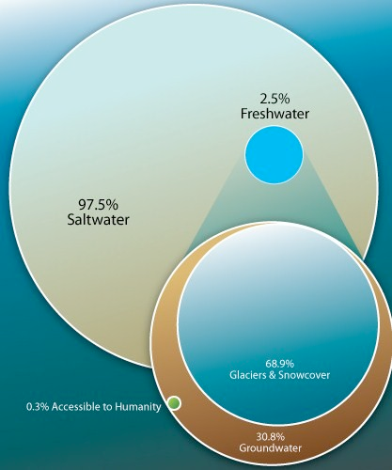
Distribution of water on Earth

Slide 4
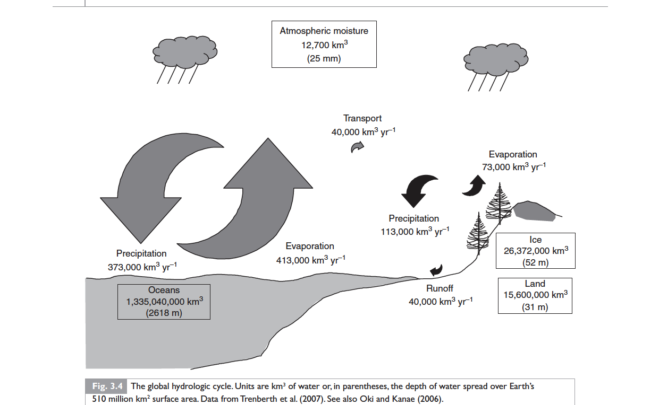

Slide 5
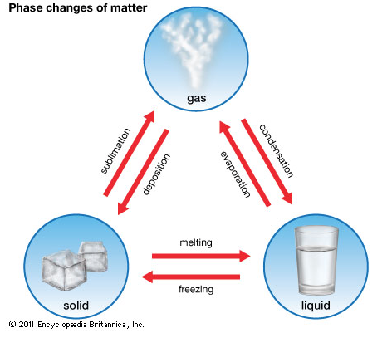
Changes of phase

Slide 6
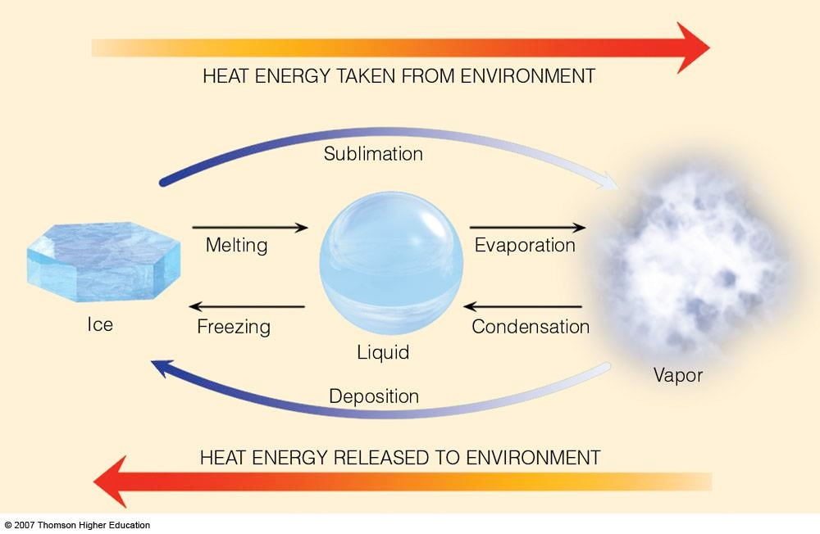
Changes of phase imply an exchange of energy

Slide 7

Latent heat
Energy transfer associated with a change of state e.g. from liquid tog as

Slide 8
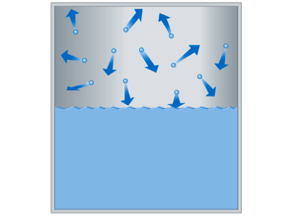
Evaporation
Evaporation: the process whereby molecules break free from a liquid (liquid --> gas)

Slide 9
Condensation
Condensation: the process in which water vapor molecules bond with adjacent water molecules
Saturation: a state of a system in which the condensation rate and the evaporation rate are equal

Slide 10
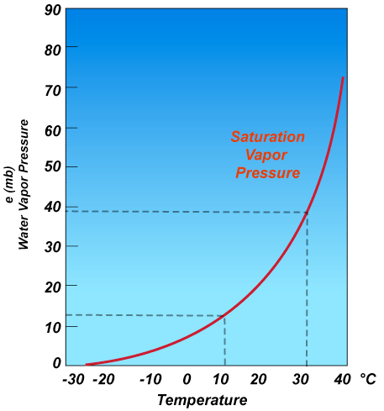
Air humidity
Vapour pressure: partial pressure exerted by water vapour as a gas
Saturation vapour pressure: maximum amount of vapor pressure that can exist in a volume of air

Slide 11
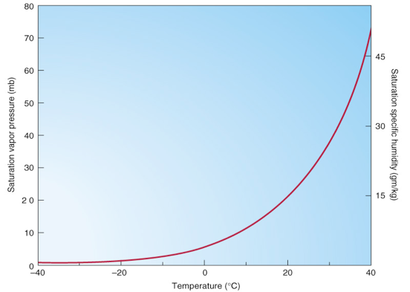
Air humidity
Specific humidity: the weight of moisture in a kilogram of air (g/kg)
Mixing ratio: : the weight of moisture in a kilogram of DRY air (g/kg)
Saturation mixing ratio: the maximum weight of moisture in a kilogram of dry air
Relative humidity: the mixing ratio relative to the saturation mixing ratio

Slide 12
Why this relationship with temperature?
Condensation:
At lower temperatures, water vapour molecules have a higher chance of condensing onto surfaces
Evaporation:
At higher temperatures, liquid water molecules have a higher chance of evaporating from surfaces

Slide 13
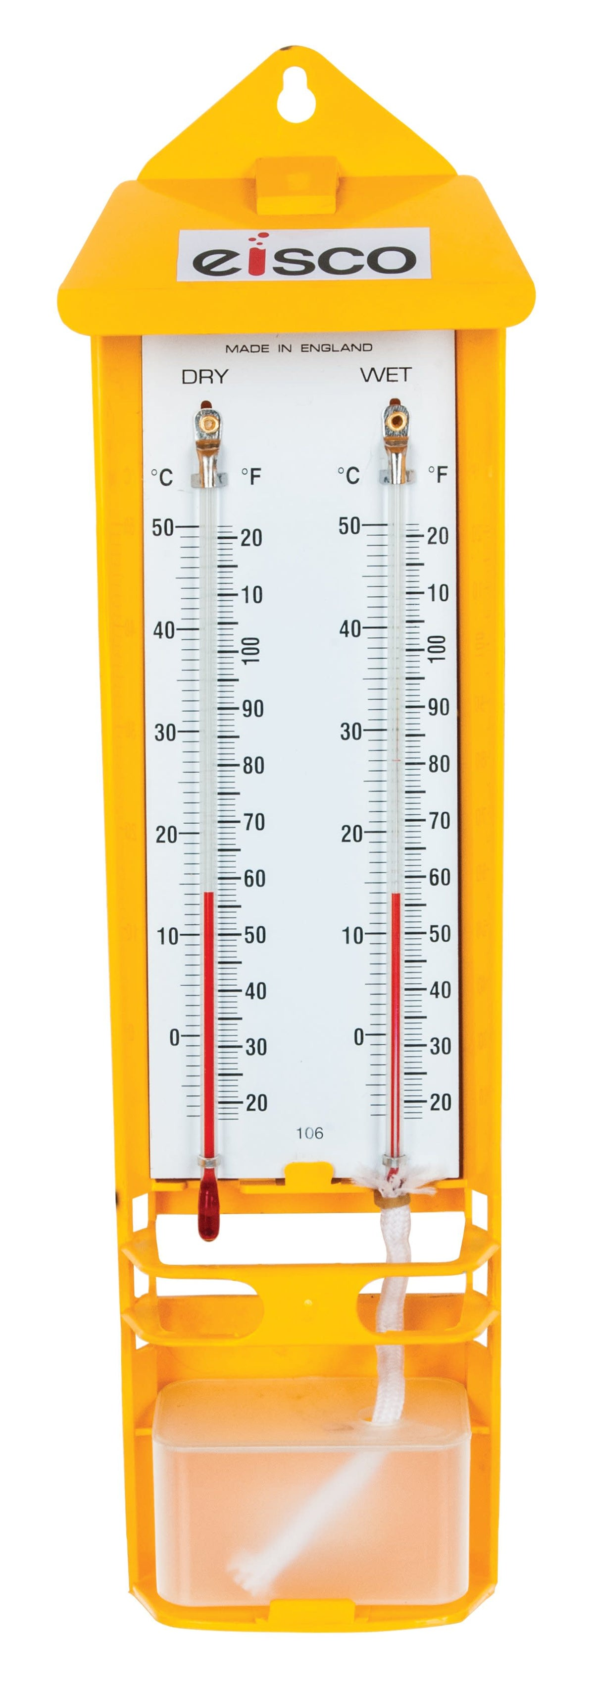
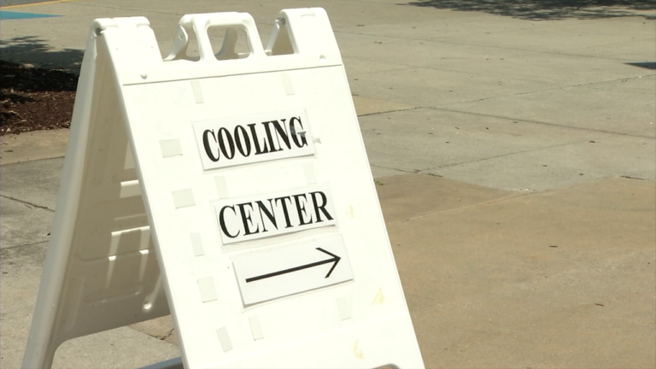
Wet bulb temperature
The lowest temperature to which air can be cooled by the evaporation of water into the air at a constant pressure
Wet bulb temperature < dry bulb temperature for RH<100%
Wet bulb temperature >35C are dangerous for human health

Slide 14

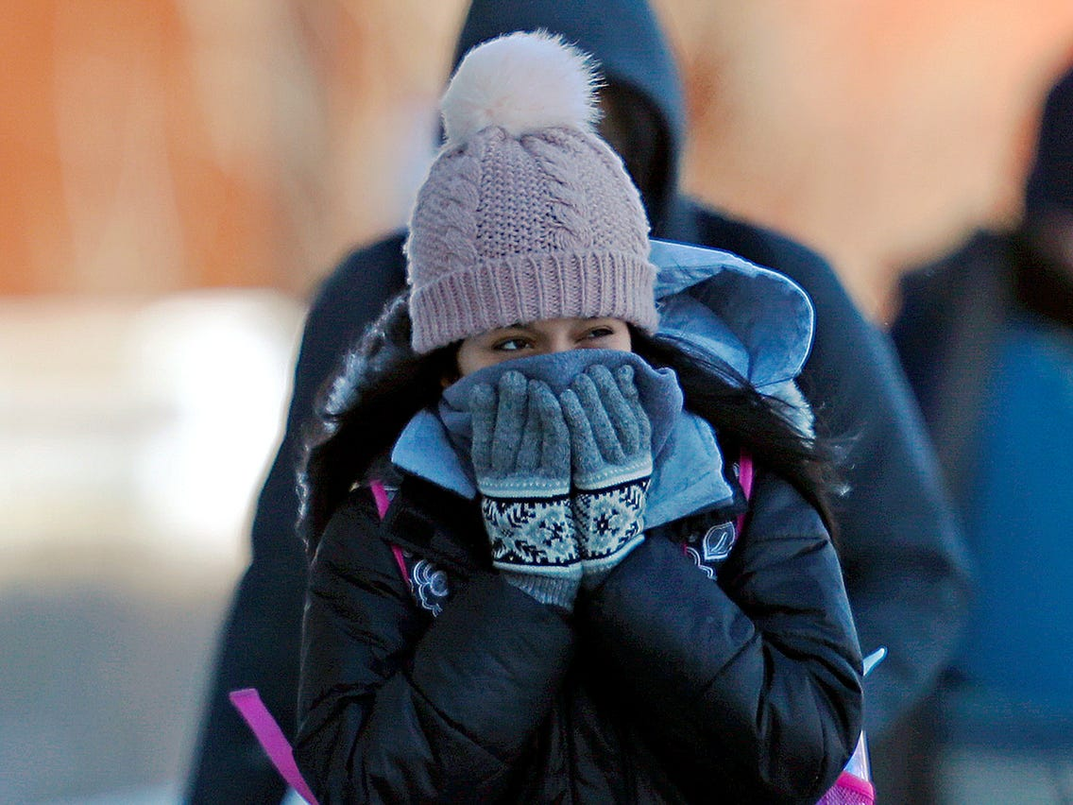
Human body temperature is controlled by evaporation from our skin

Slide 15
Natural surfaces are not closed systems
Air movement shifts water vapour upwards or to new locations
Evaporation from land more complex than from water

Slide 16
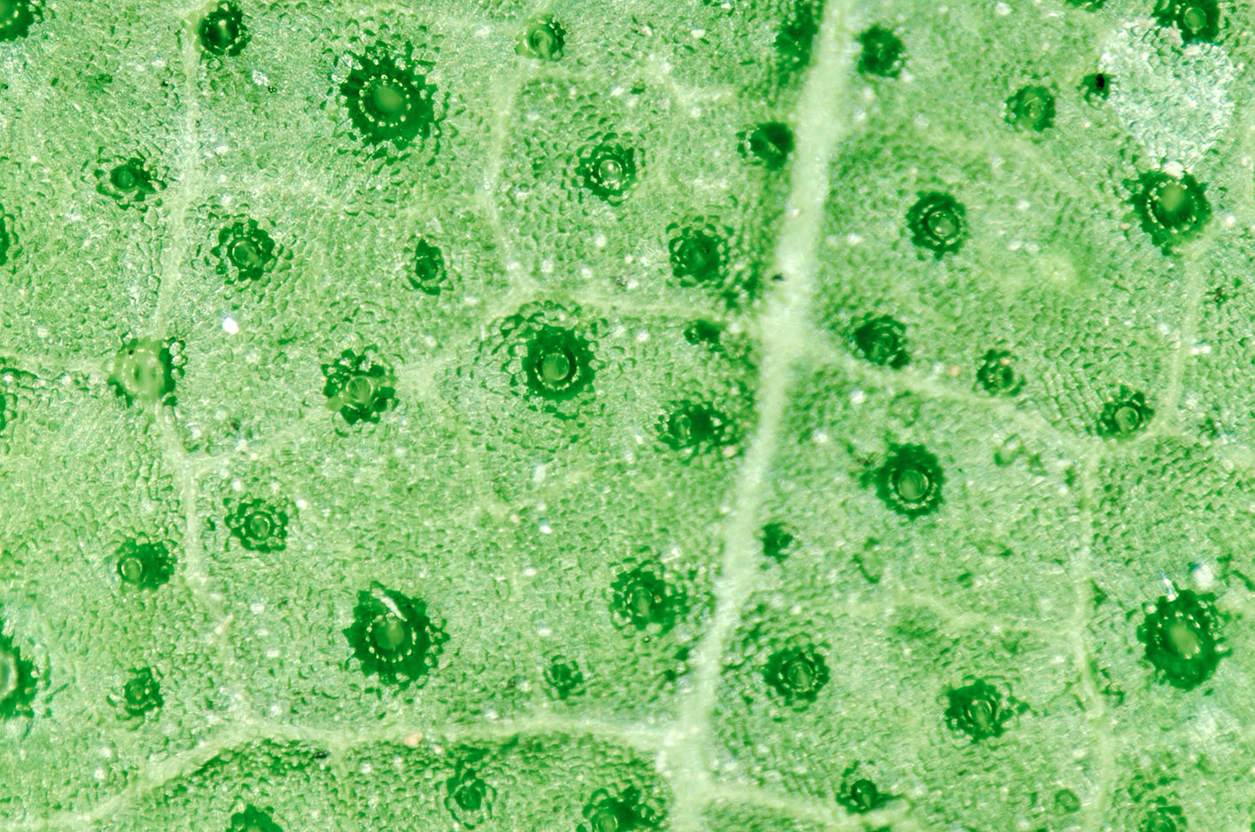
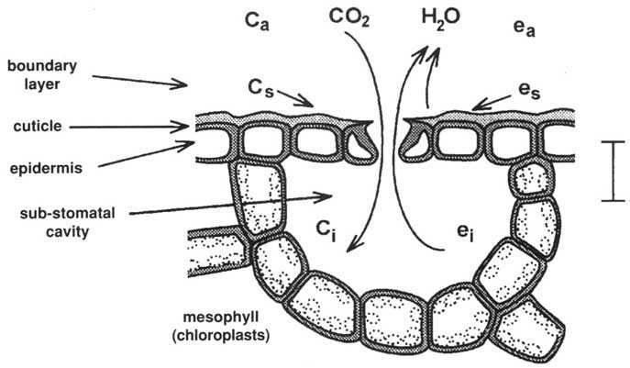
Transpiration
Plants have control over both uptake and water loss through stomata
Transpiration if functionally different from evaporation

Slide 17
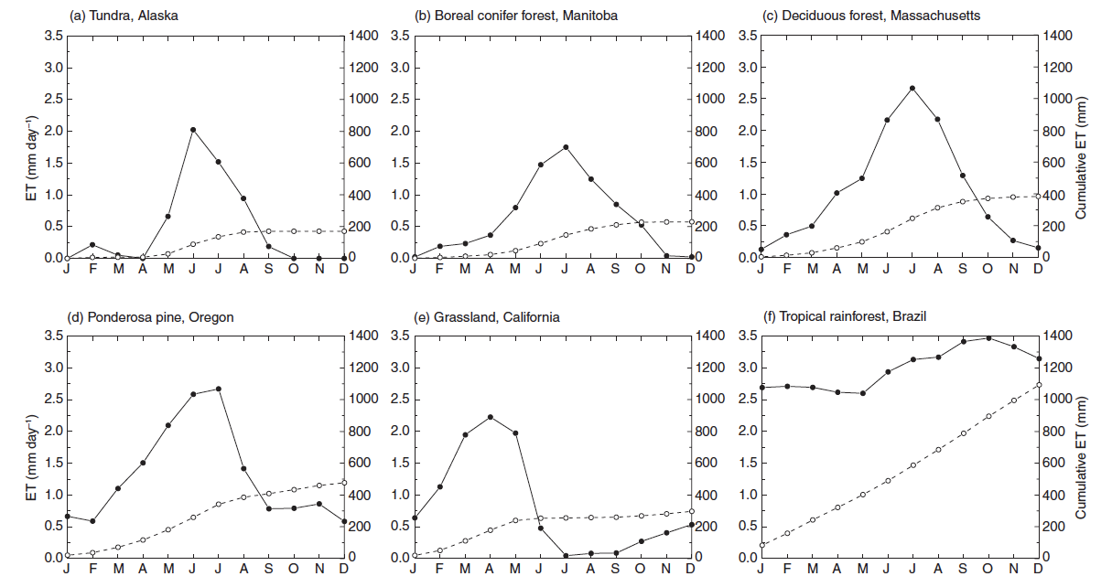
Evapotranspiration differs between ecosystem types
Notes:
Ecological Climatology chapter 10, figure 10.3

Slide 18
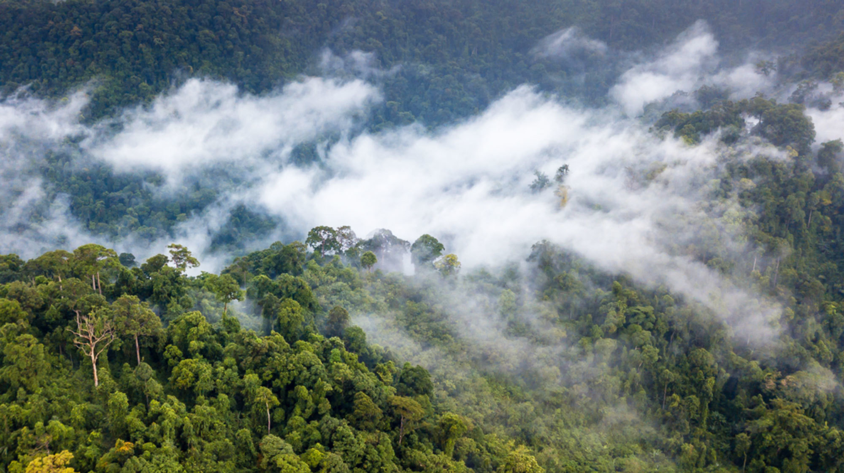
Vegetation control over the water cycle

Slide 19
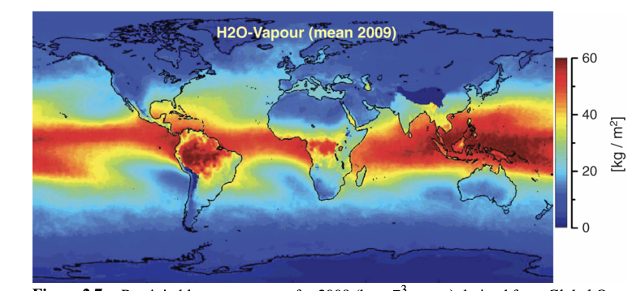
Global air humidity
Notes:
Essentials of the Earth’s Climate System, chapter 2.2

Slide 20
Notes:
Ecological Climatology, chapter 10

Slide 21
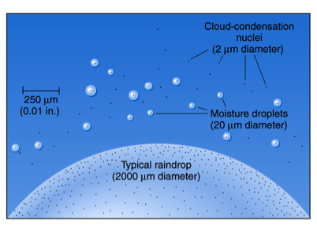
Cloud formation
Condensation on cloud condensation nuclei

Slide 22

Precipitation only occurs when water droplets are heavy enough to fall

Slide 23
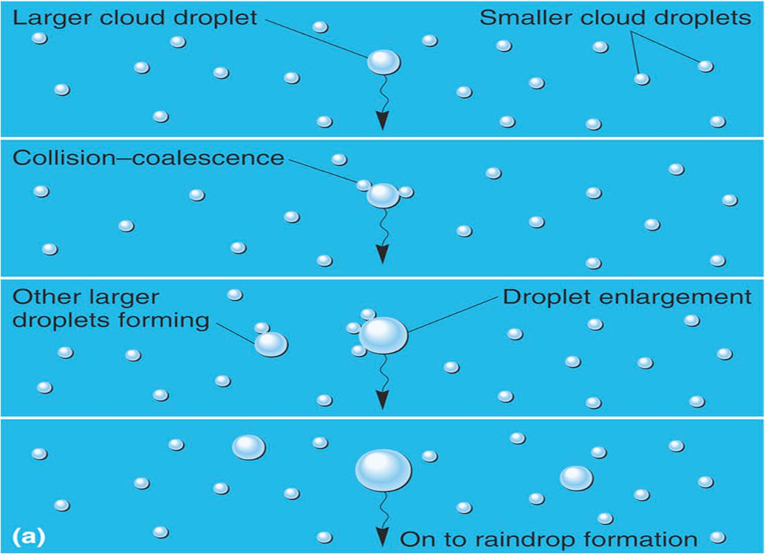
Droplet formation in warm clouds

Slide 24
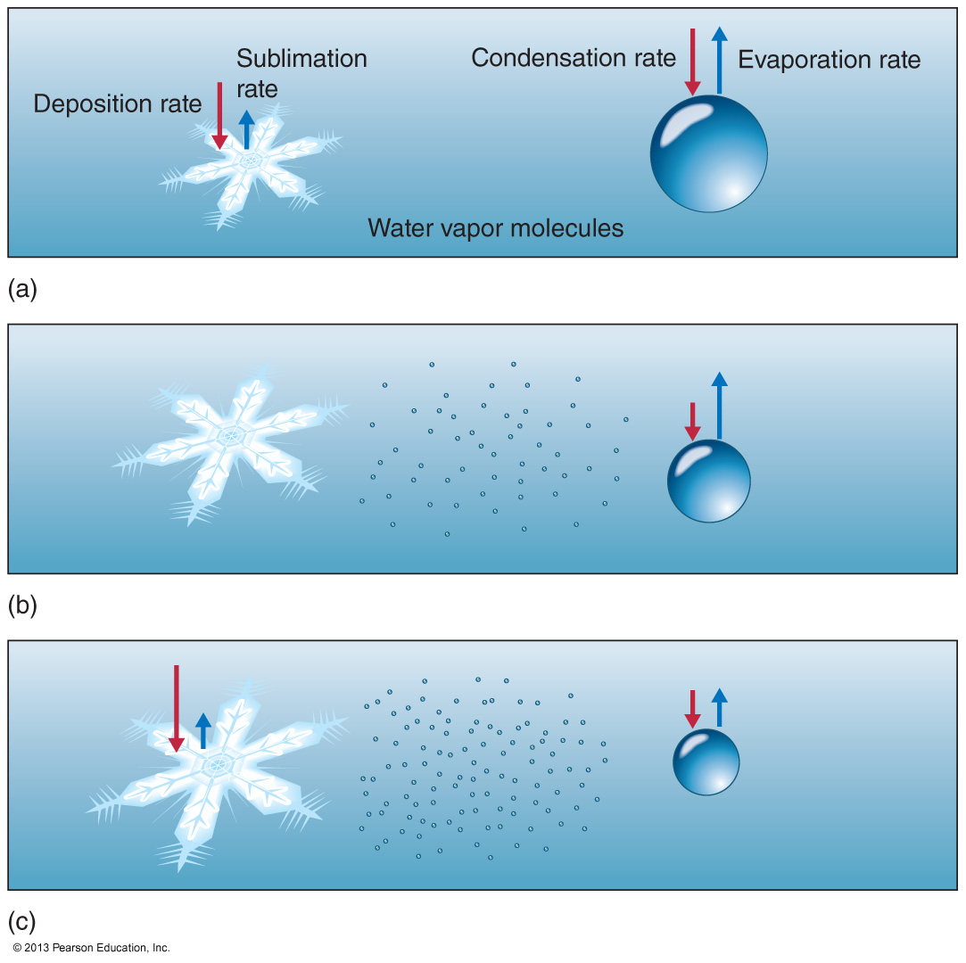
Droplet formation in cold clouds
Supersaturated air is air with a relative humidity higher than 100.
This process can occur in the absence of condensation nuclei or if two air parcels of differing temperatures mix together

Slide 25
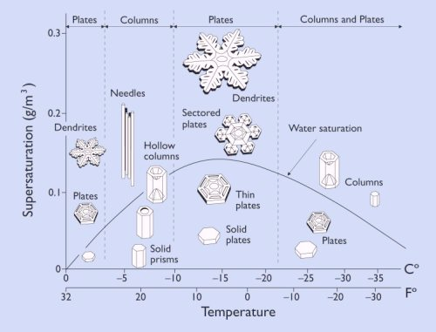

Slide 26
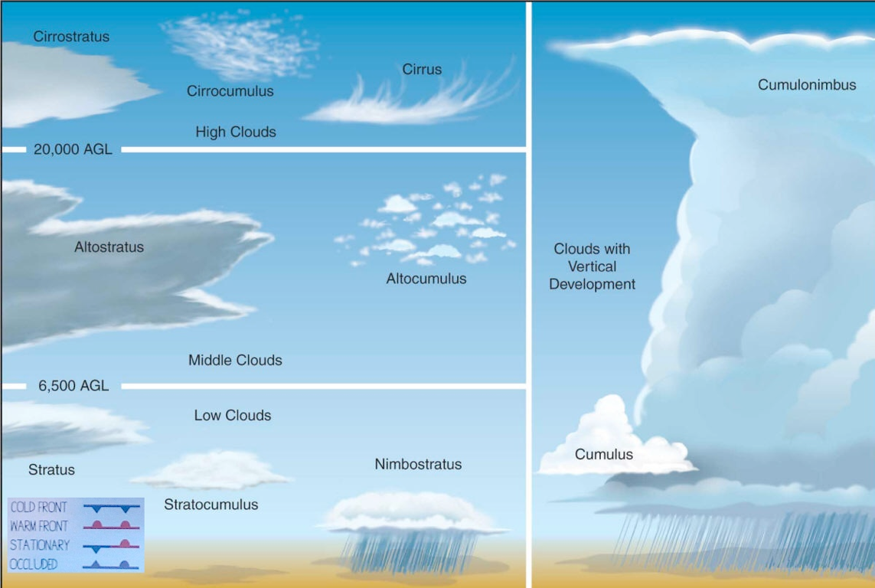
Cloud types

Slide 27
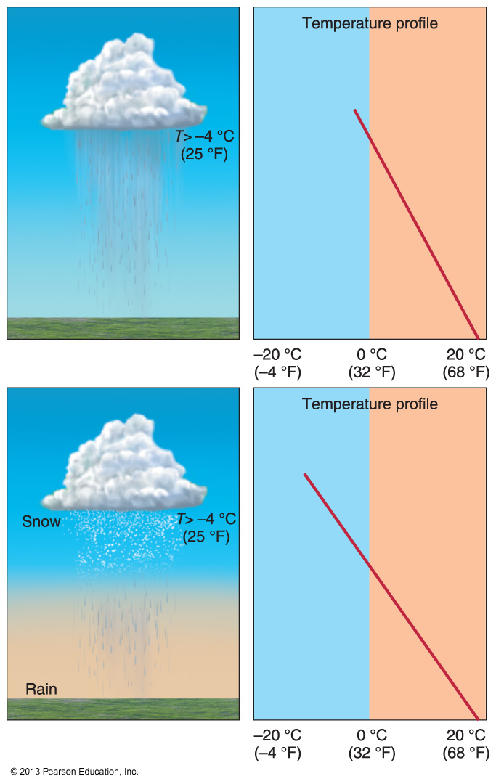
Precipitation: rain

Slide 28
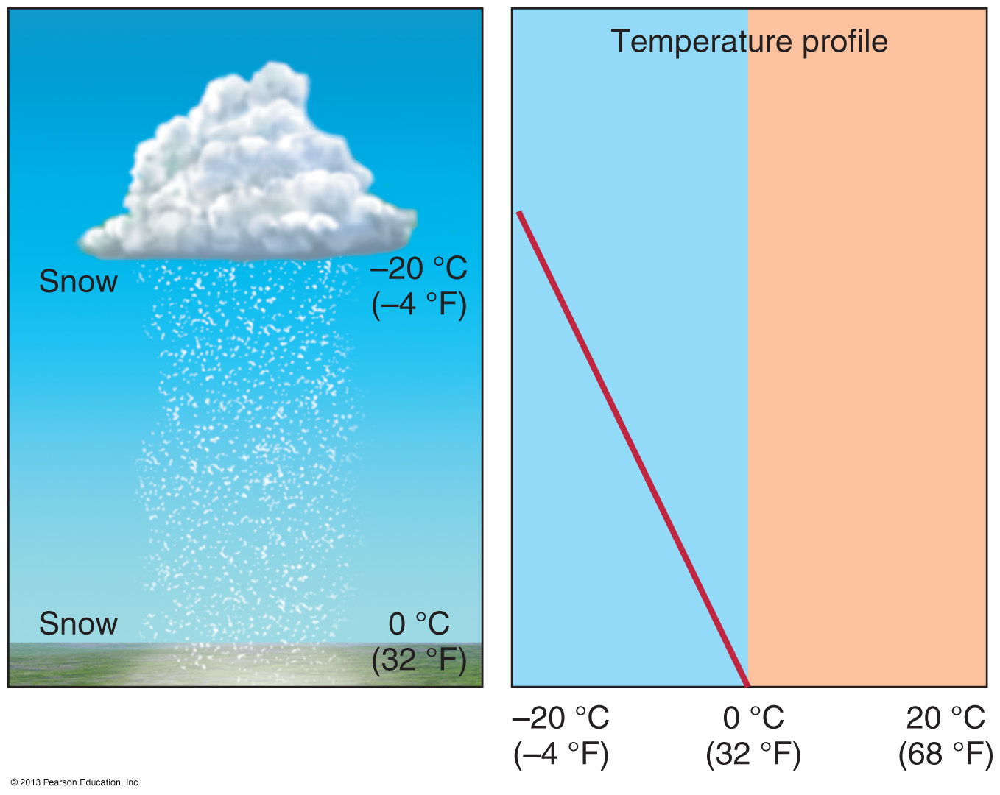
Precipitation: snow

Slide 29
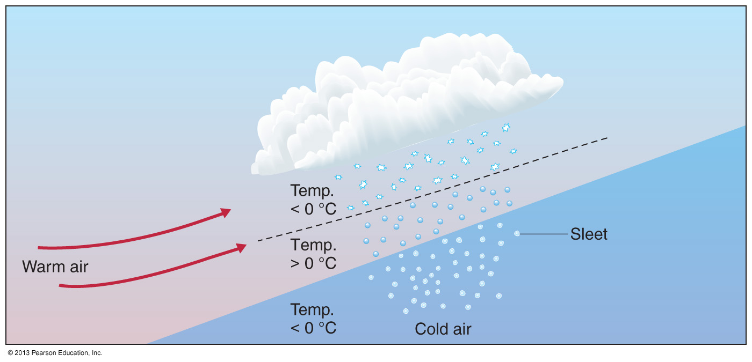
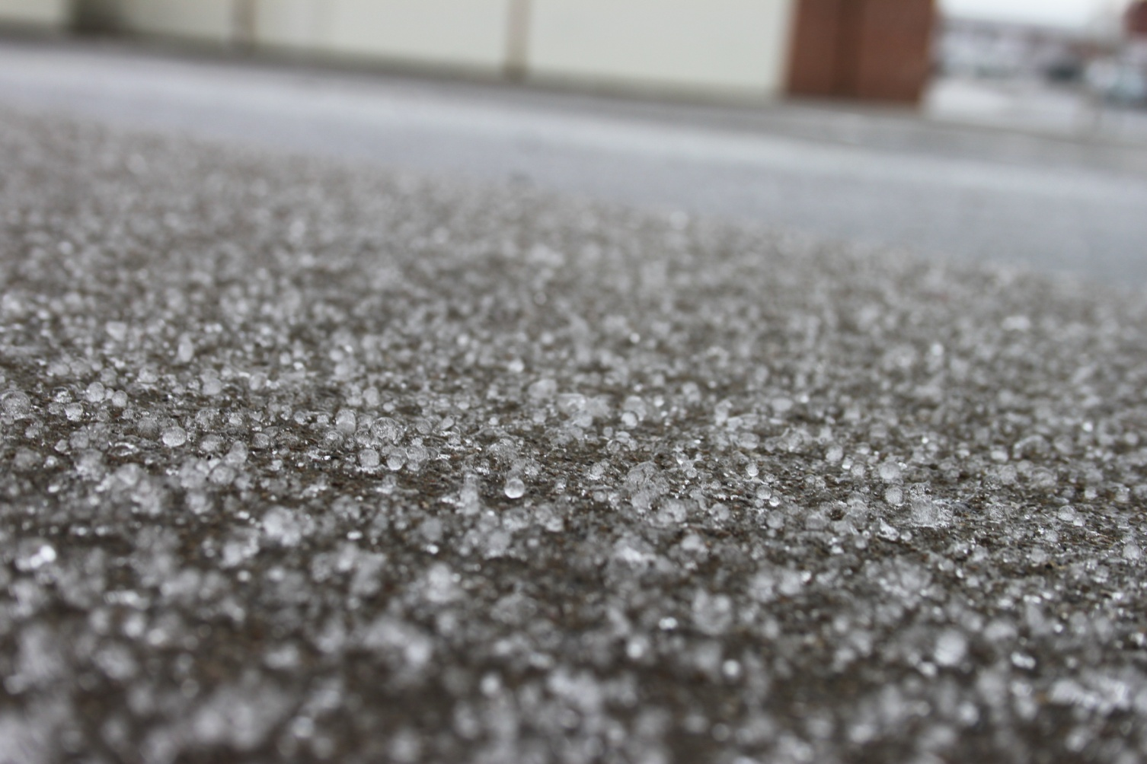
Precipitation: sleet

Slide 30
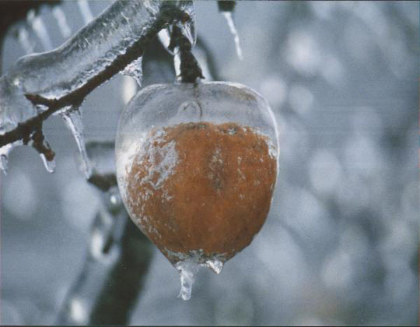
Freezing rain
Cold air layer too thin for water to freeze – reaches sub zero surface as liquid

Slide 31
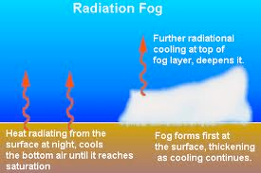
Fog
Fog: a cloud whose base is at or near the ground
Radiation fog (ground fog): fog that forms when nighttime cooling drops temperature below the dew point
Most likely to occur on an otherwise cloudless night
Typically dissipates within a few hours of sunrise
Thick radiation fog can limit insolation and warming and persist all day

Slide 32
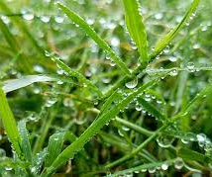
Dew formation
Condensation of water vapour from the air onto cold surfaces

Slide 33
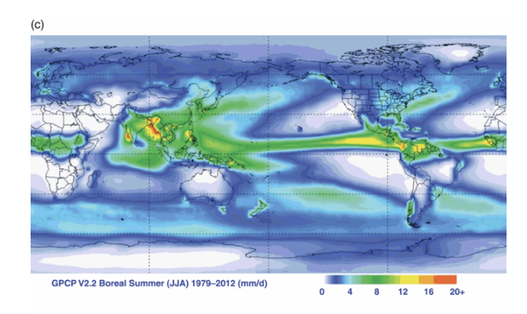
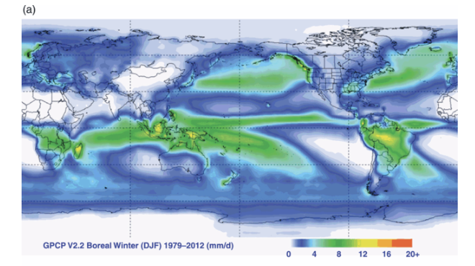
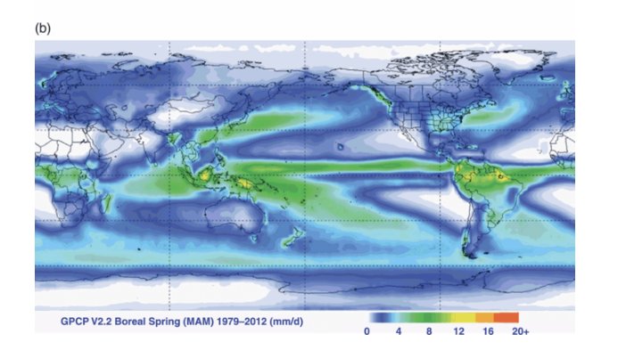
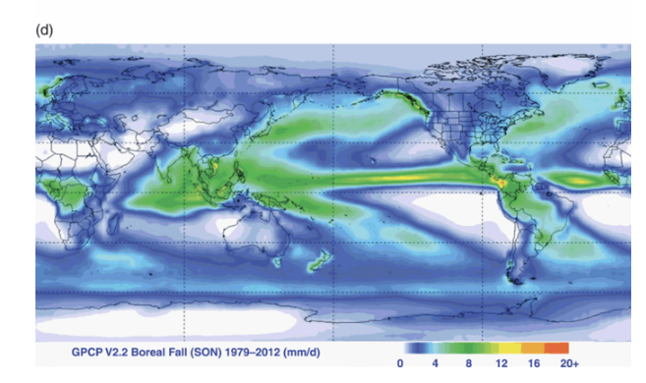
Global precipitation patterns

Slide 34
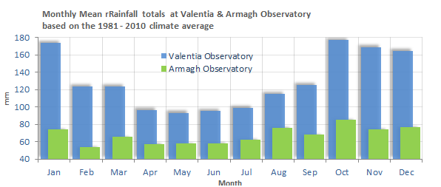
Precipitation seasonality in the mid-latitudes - Ireland

Slide 35
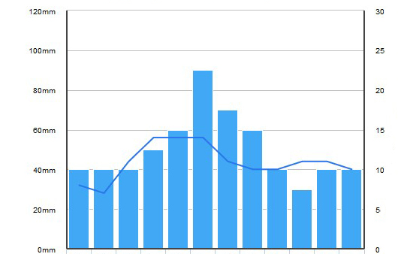
Precipitation seasonality in the mid-latitudes - Romania

Slide 36
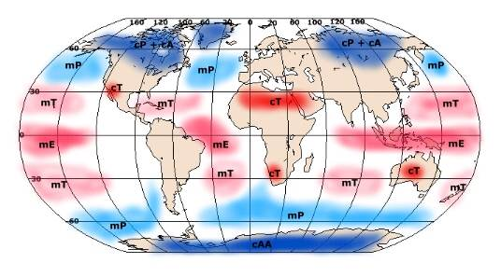
Seasonality is driven by the movement of different air masses

Slide 37
Seasonality is driven by the movement of different air masses
Movement of cold wet air in winter

Slide 38
Seasonality is driven by the movement of different air masses
Movement of cold dry air in winter

Slide 39
Global precipitation patterns

Slide 40
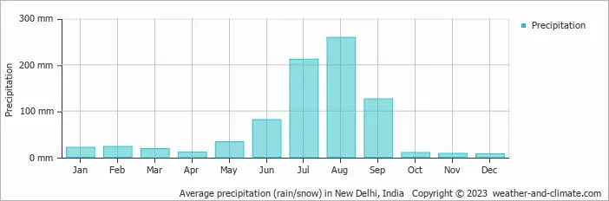
Precipitation seasonality in the lower latitudes - Delhi

Slide 41
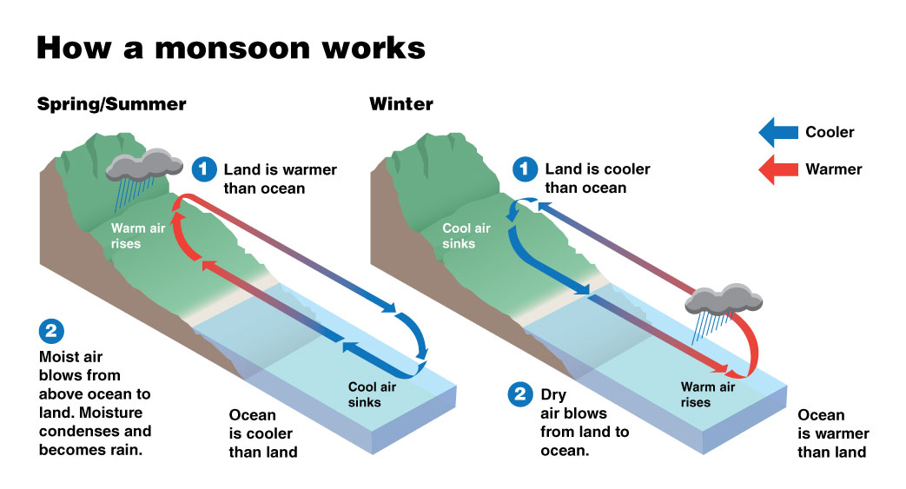
Monsoons

Slide 42
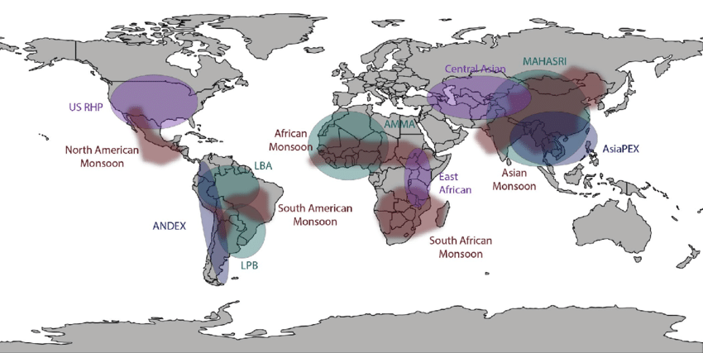
Monsoons

Slide 43
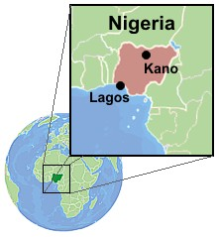
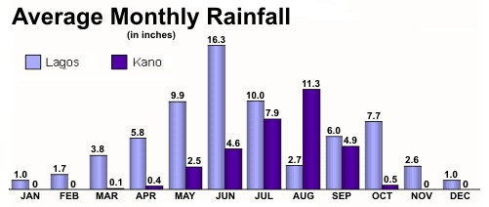
Precipitation in the low latitudes - Nigeria

Slide 44
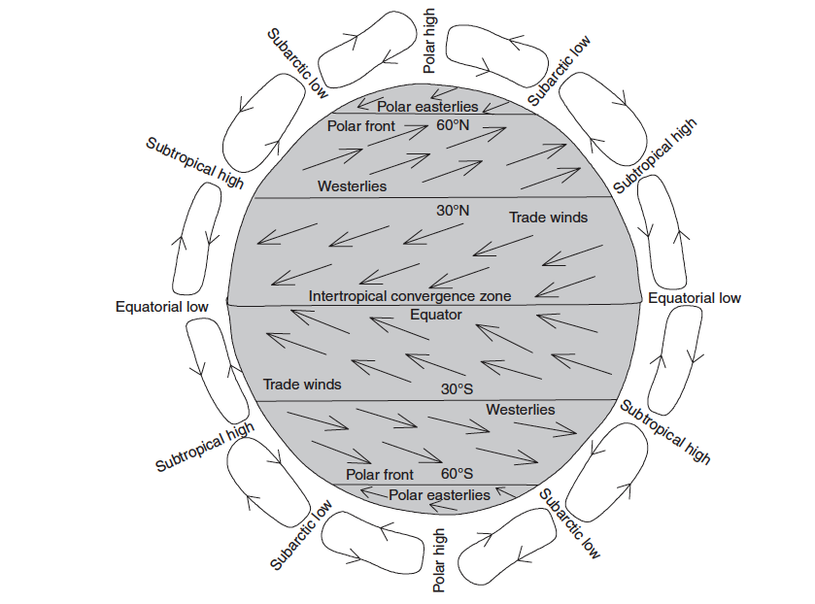
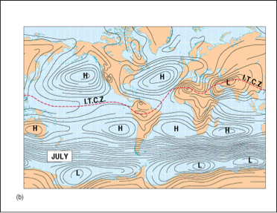
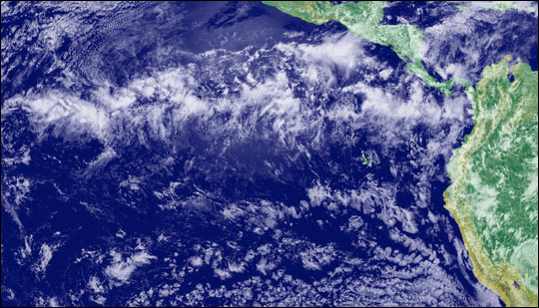
Intertropical convergence zone (ITCZ)
Convergence of northeast and southeast trade winds in equatorial regions creates the intertropical convergence zone

Slide 46
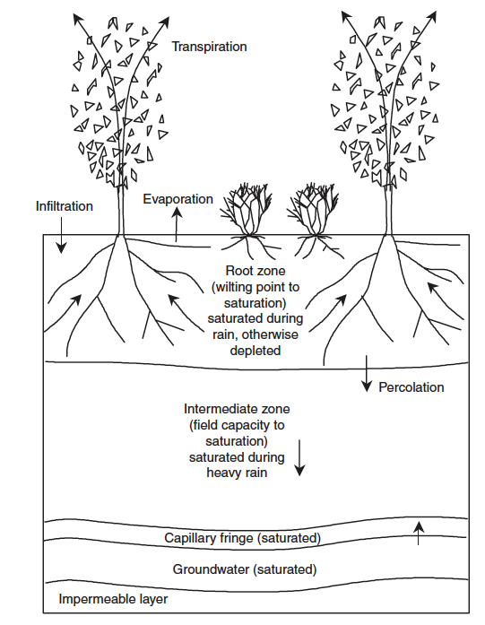
Fate of precipitation on the surface

Slide 47
Atmosphere
Climate fundamentals
Predicting climate
Atmosphere
Global C cycle
IPCC report
Earth system models
Climate impacts
Climate solutions
Extreme events
Tipping points
Sea ice, ice caps,
Energy
Mitigation
Nature-based solutions

